Slide 1
APOLOGETICS
IN ONE LESSON
almost
Ai1L.net
Lesson 24
Jesus Died by Crucifixion; His Disciples Believed He Resurrected

Slide 2
Read the non-Christian accounts of Jesus’ death by crucifixion
1

Slide 3
Read the Gospels accounts of Jesus’ death by crucifixion
2

Slide 4
Document the claims of the early witnesses of Jesus’ resurrection
3

Slide 5
“This is the sort of truth that is hard to explain because it is a fact; but it is a fact to which we can call witnesses”
G.K. Chesterton The Everlasting Man

Slide 6
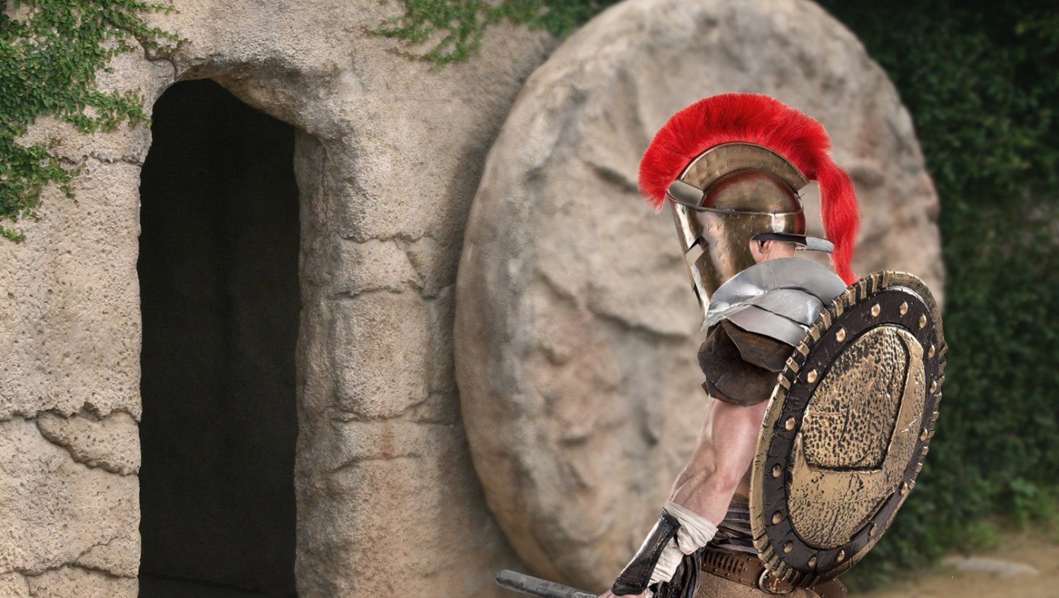
Roman Authorities Investigating Jesus For Violating Stay-In-Tomb Order
FRIEDRICH NIETZSCHE Thus Spoke Zarathustra

